Slide 1


Fall School-Based Family Data Night
November 17, 2022

Slide 2

MSCS VISION FOR STUDENT SUCCESS
VISIÓN DE MSCS PARA EL ÉXITO DE LOS ESTUDIANTES
We envision Memphis-Shelby County Schools (MSCS) becoming a transformational district that provides opportunities for innovation to meet the needs of all scholars.
Prevemos que las escuelas del condado de Memphis-Shelby (MSCS) se conviertan en un distrito transformador que brinde oportunidades de innovación para satisfacer las necesidades de todos los estudiantes.

Slide 3
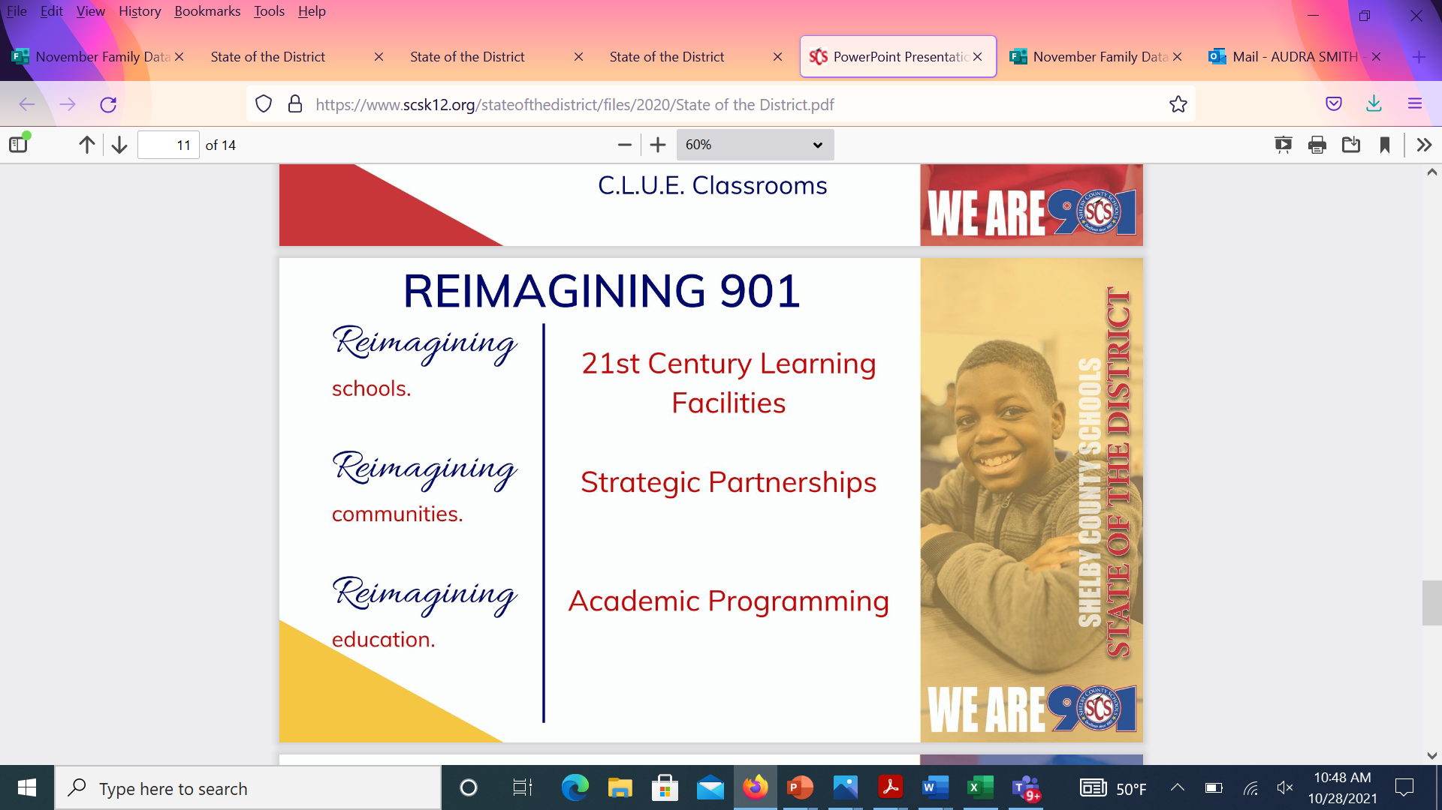

Slide 4
Agenda
School Communication Updates (ex. Tutoring, Class Dojo, Weekly/Daily Communications, Emails, Upcoming virtual Parent Meetings)
Upcoming FACE Parent Support Opportunities
Community Based Parent Support Opportunities
MSCS Tutoring Opportunities
Registration/Enrollment, Withdrawals, & Transfers
Questions & Answers
Student Data Discussions
Purpose of School-Based Family Data Night
Accessing the SCS Parent Portal (Report Cards/ Progress Reports)
PowerSchool Academic Score Card
Assessment Department Resources for Families
Mastery Connect Updates K-8
Elementary/Middle – iReady Diagnostic/Parent Reports (Grade K-8)
Secondary - Naviance (Grades 6-12)
Advanced Academics

Slide 5
Purpose
Objetivo
Inform parents on student progress with various assessments
Provide guidance on how to read data reports
Provide recommendations on how to assist students
Informar a los padres sobre el progreso de los estudiantes con varias evaluaciones.
Proporcionar orientación sobre cómo leer los informes de datos
Proporcionar recomendaciones sobre cómo ayudar a los estudiantes.
Notes:
Why are we here? The purpose of this family data night is to inform parents on student progress with various assessments, provide guidance on how to read data reports, and provide recommendations on how to assist students.

Slide 6
Accessing and Viewing the Report Card

Slide 7
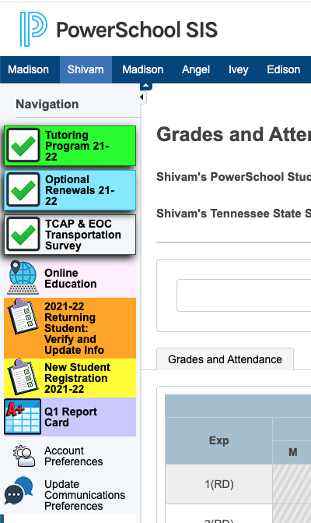
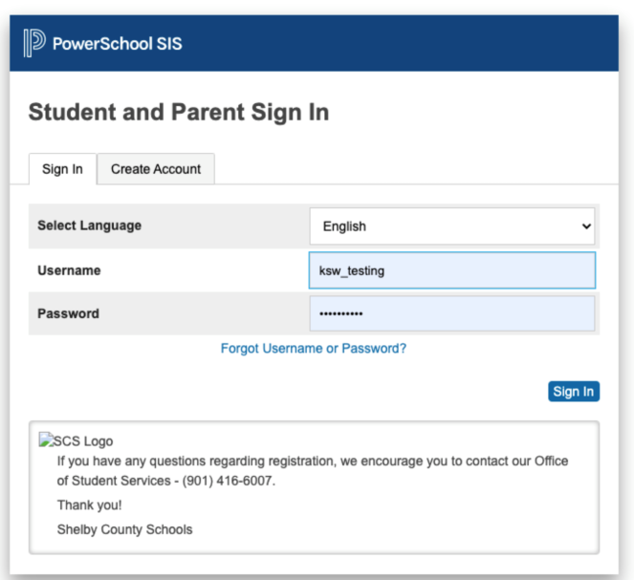
Accessing and Viewing the Report Card
Report cards will be available for the complete quarter once all school grades are stored and will be housed in the parent portal.
Access the report card, using the following link: https://scstn.powerschool.com/public/home.html
Sign into your parent account.
If you have forgotten the username or password, click on the “Forgot Username or Password” link.
After logging in, click the report card icon.

Slide 8
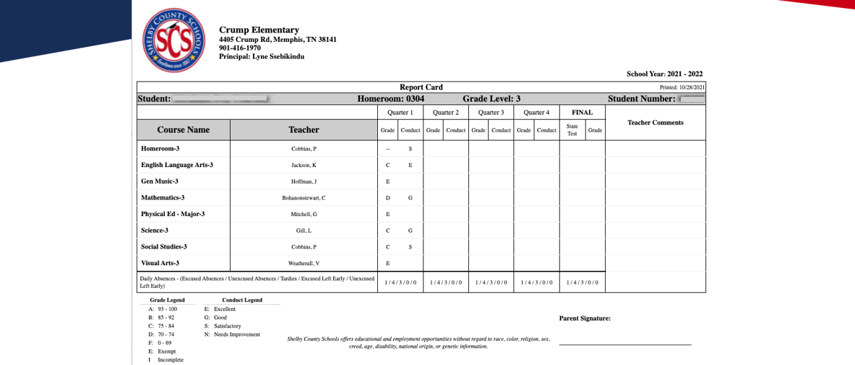

Accessing and Viewing the Report Card

Slide 9

PowerSchool Academic Scorecard

Slide 10

What is the Academic Scorecard?
The Academic Scorecard is a report available in PowerSchool that allows parents and guardians the ability to view their child’s academic, attendance, and behavior data in one centralized location.
It can be found by logging into PowerSchool using your normal username and password.

Slide 11

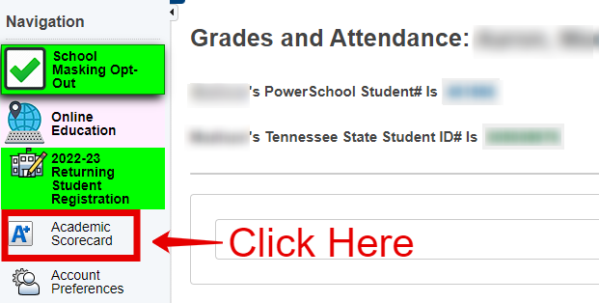
Where is it?
Once you log in to PowerSchool, on the menu to the left of the screen, you should see the ‘Academic Scorecard’ button.

Slide 12
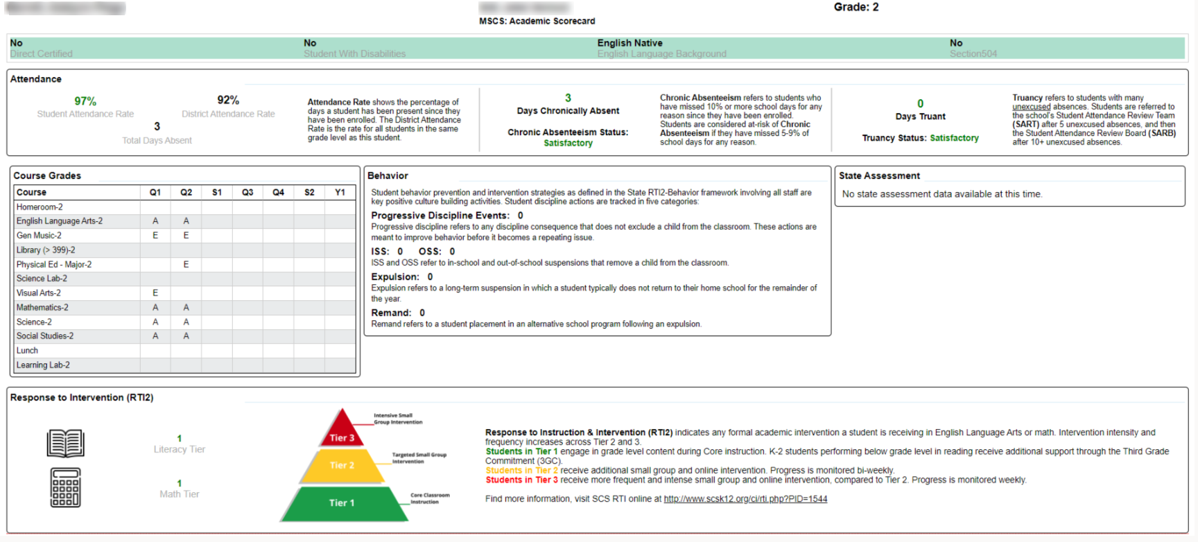
Example Scorecard

Slide 13
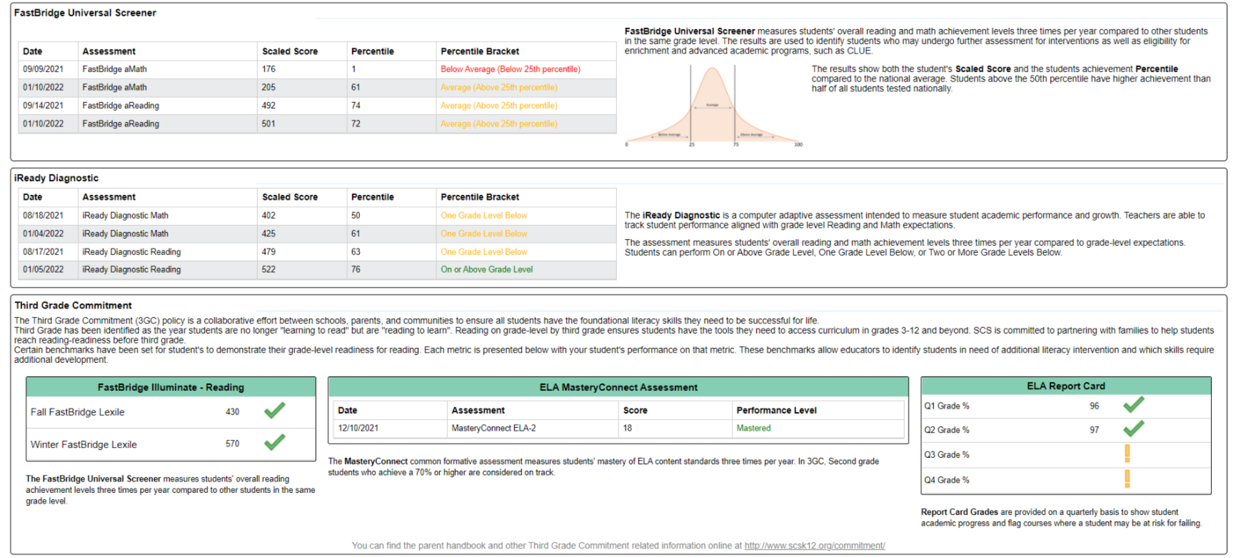
Example Scorecard

Slide 14
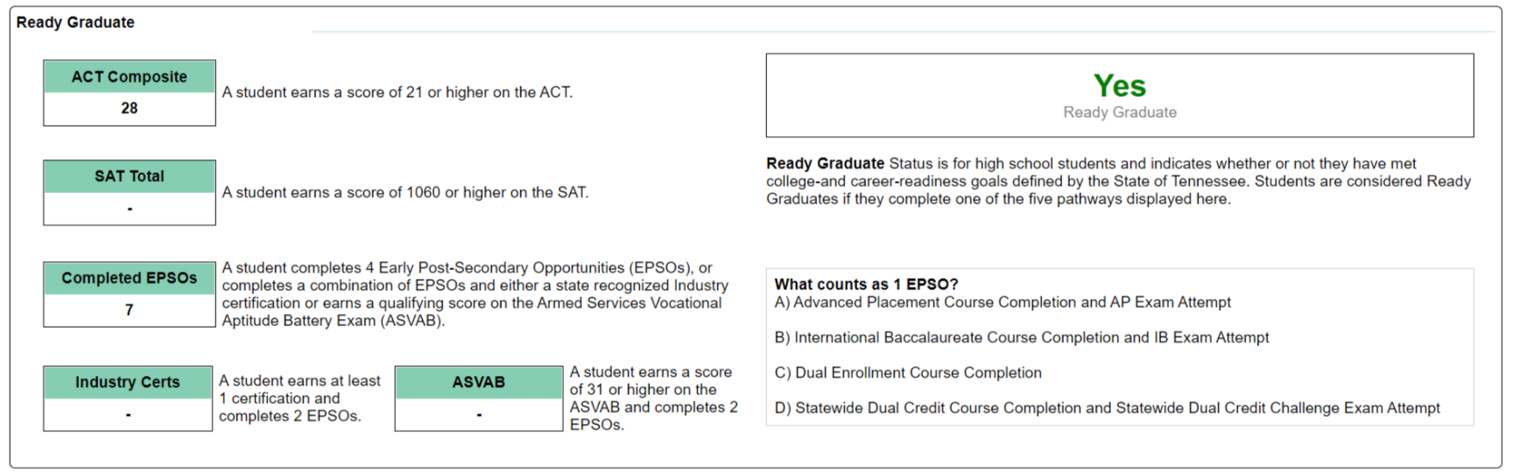
Ready Graduate

Slide 15
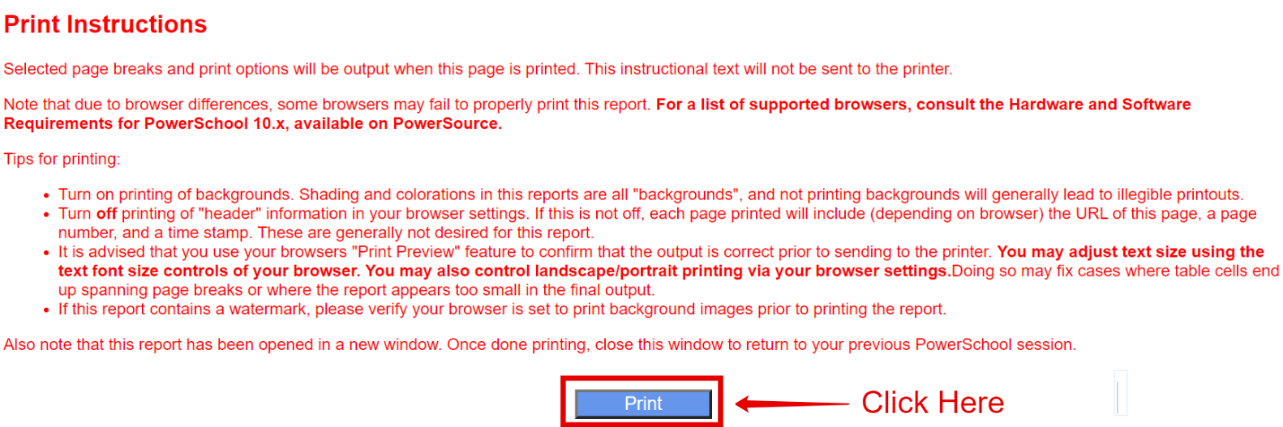
How to Print?
Above the report, you should see more detailed printing instructions in red and a blue ‘Print’ button right above the report itself.

Slide 16
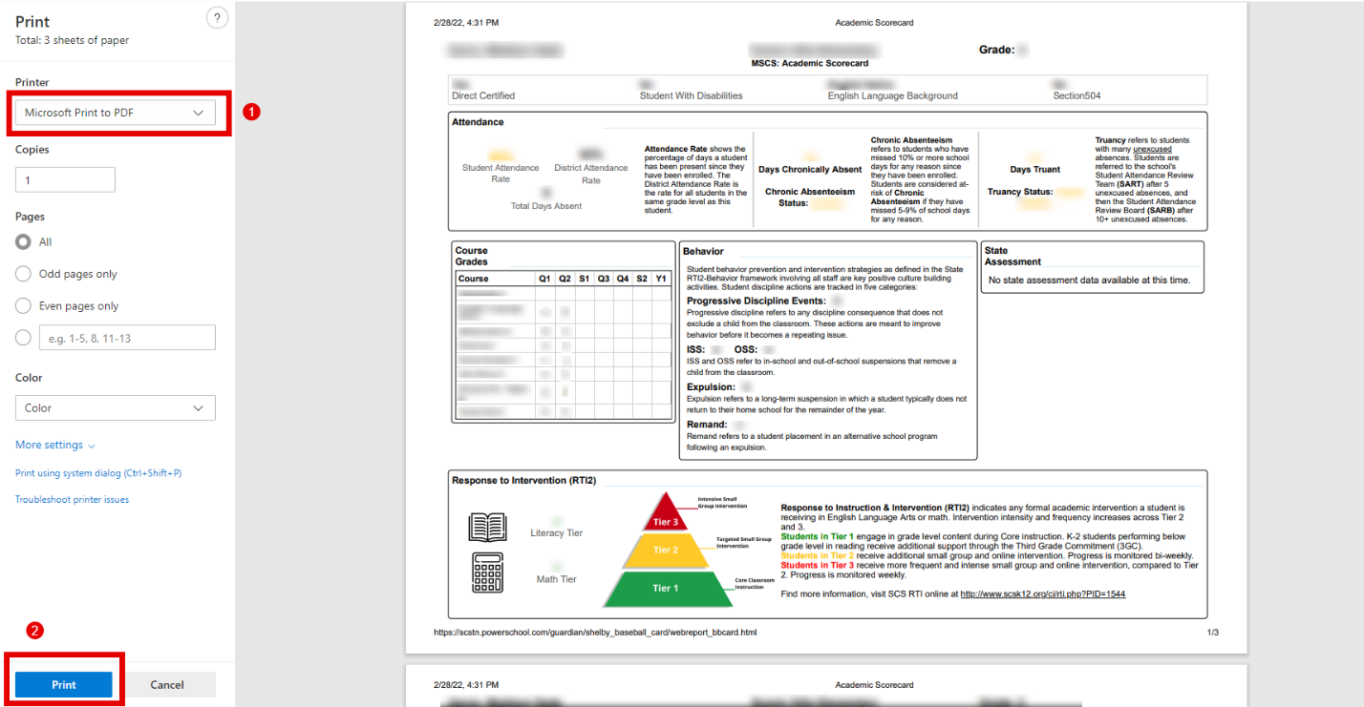
How to Print?
Once you click the blue ‘Print’ button at the top of the report, you will open a print menu. From here you can select the device you would like to print to (1) and then click Print (2).

Slide 17
Assessment Department Resources for Families

Slide 18
Testing Information
The following resources can be found on the Assessment page of the MSCS website (http://www.scsk12.org//assessment/):
The 2021-2022 Assessment Calendar
Assessment Rationale Document

Slide 19
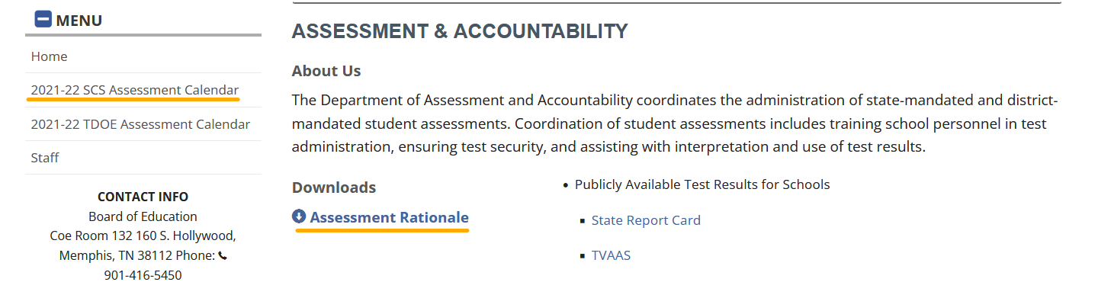
Testing Information

Slide 20
TCAP Family Portal
The TCAP Family Portal is provided by the Tennessee Department of Education.
Parents can access the TCAP Family Portal at familyreport.tnedu.gov.
Parents can access their students’ test scores using the TCAP Family Portal.
One barrier to parents using the TCAP Family Portal is that it requires them to know their child’s TN student ID. This TN Student ID is different than the student’s PowerSchool ID. It is also important to put two zeros in front of the student’s 7-digit ID.

Slide 21
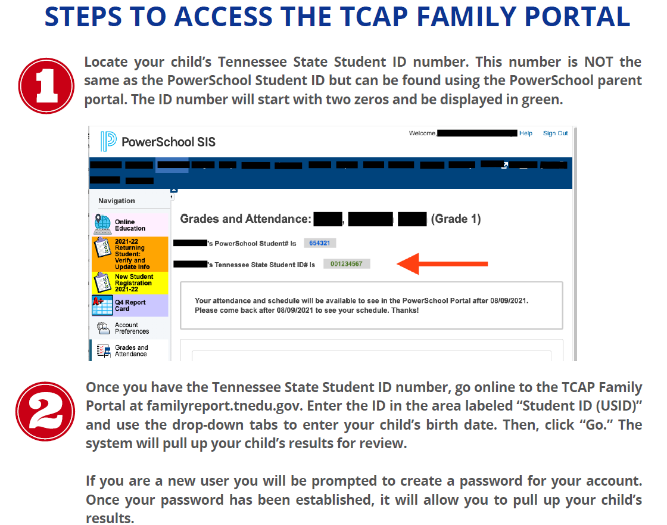
TCAP Family Portal

Slide 22
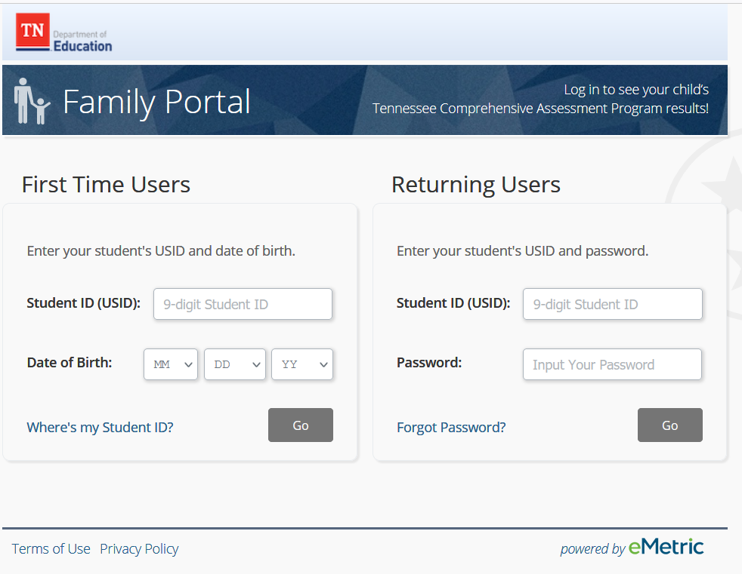
TCAP Family Portal

Slide 23
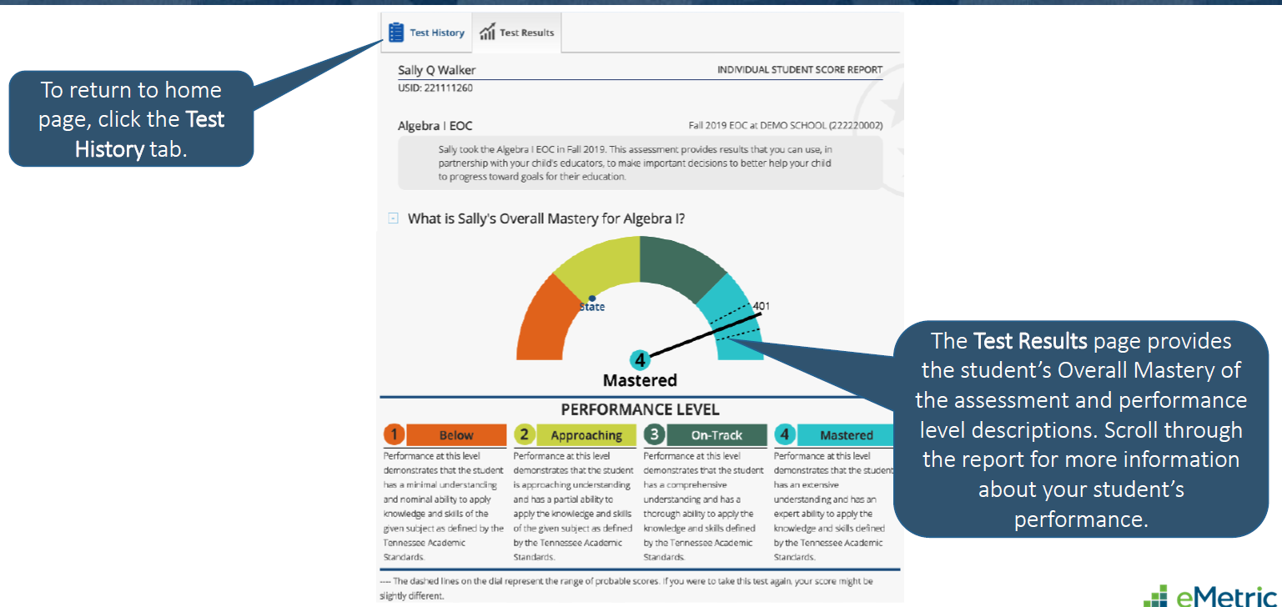
TCAP Family Portal

Slide 24
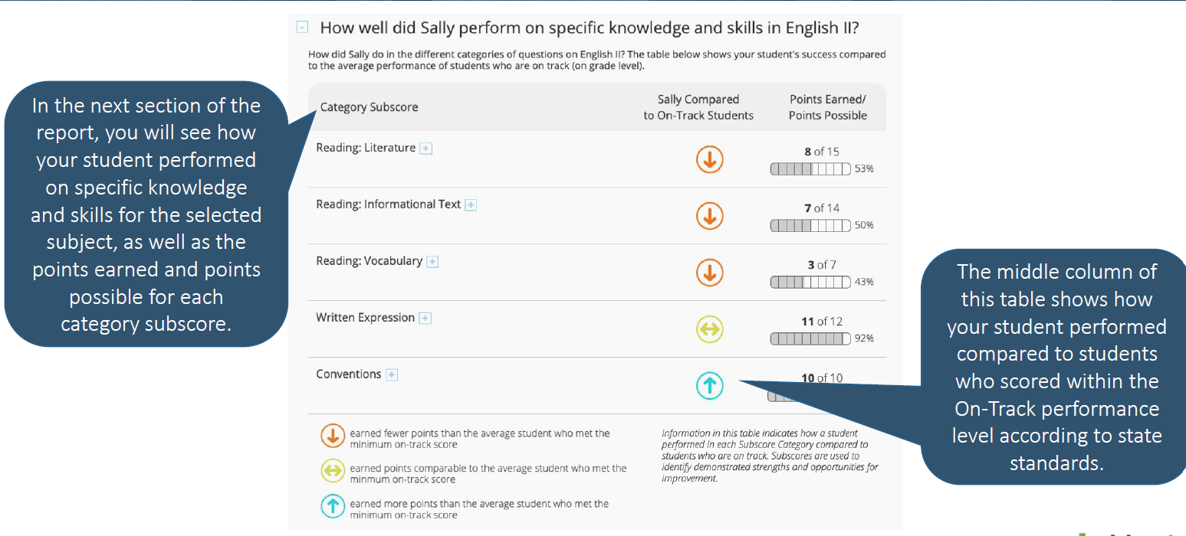
TCAP Family Portal

Slide 25
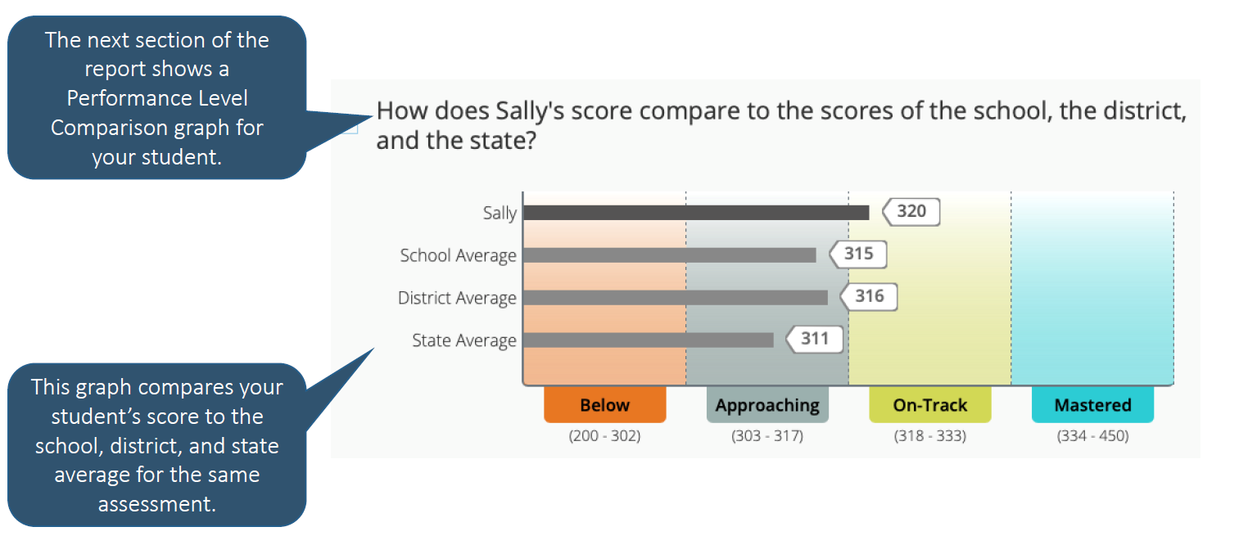
TCAP Family Portal

Slide 26
School’s Current Data and Academic Goals

Slide 27
School’s Data and Academic Goals
SUBJECT – OTM – ALL GRADES | TICS Current Data – TN READY 2021-2022 | TICS GOAL for 2022-2023
ELA | 14.4% | 25.1%
MATH | 12.7% | 23.6%
SCIENCE | 13.7% | 26.6%
SOCIAL STUDIES | 31.1% | 41.4%

Slide 28
Mastery Connect Data

Slide 29
MASTERY CONNECT
Grades K-12 will participate in standards-based assessments aligned with district ELA, math, and science curriculum maps.
Mastery Connect is an assessment platform that allows teachers to assess student mastery of specific standards.
Students can receive results instantly.
The results are displayed by standard, so although students will still get an overall percentage on any assessment taken, the focus is on the mastery of the specific standards.

Slide 30
Mastery Connect – ELA
District Formative Assessments

Slide 31
Mastery Connect – MATH
District Formative Assessments

Slide 32
Mastery Connect – Science
District Formative Assessments

Slide 33
iReady Data

Slide 34
i-Ready
iReady is a computer-adaptive test (CAT).
Computer-adaptive tests continually adjust the difficulty of each test by determining each question based on the previous response.
The iReady assessment is used as a diagnostic screening tool to identify students who may need additional academic support and monitor student growth.
iReady is a K-8 intervention that provide specific tools and lessons to support areas the individual student is struggling.
In addition, iReady can help teachers determine appropriate instructional areas and skills to focus on during small group intervention instruction.

Slide 35
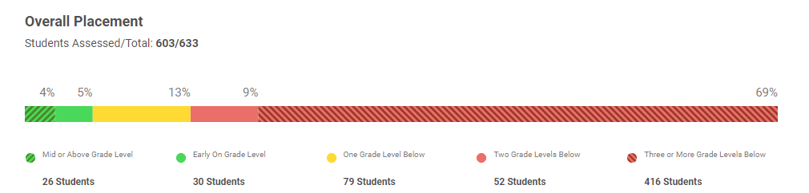
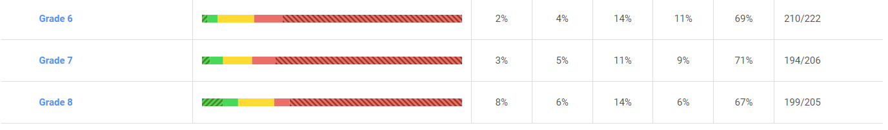
i-Ready Data
ELA DATA

Slide 36
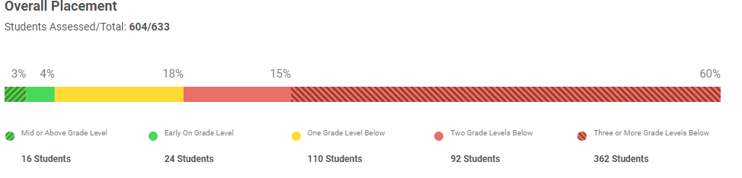
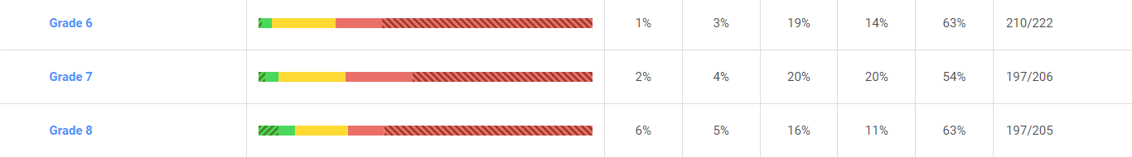
I-Ready Data
MATH

Slide 37
Universal Screener:
i-Ready

Slide 38
Universal Screener: i-Ready
Grades K-8 will participate in skill-based reading and math screener assessments.
i-Ready is the newly selected RTI² assessment platform for students in grades K-8 and will replace Illuminate/FastBridge in the 2022-2023 school year.
i-Ready can be used in both special education and regular education in order to meet the state guidelines related to effective implementation of RTI².
i-Ready provides in-depth information on students' strengths and areas of need for specific skills in reading and math.
The goal of the process is to monitor student progress as the student receives intervention with the expectation that the intervention will result in the student achieving at high levels of learning while closing the achievement gap among same-age peers.

Slide 39
Naviance

Slide 40
Naviance
Naviance helps students uncover their strengths and unique skills so they can develop confidence and see their potential.
Naviance connects the dots between student interests and college and career choices and stay motivated to choose the choose their best-fit postsecondary path.

Slide 41
Naviance
Our 8-12th grade students utilize Naviance to develop a 4-Year Focused Plan of Study

Slide 42
Purpose
Participating in the 4-Year Focused Plan of Study activity provides an opportunity for Students and Parents/Guardians to:
Learn about graduation requirements, early post-secondary opportunities (EPSOs), and elective focuses available to students. Ready Graduate Video
Explore course options for grades nine through twelve (9-12) based on their skills, interests, goals, and postsecondary aspirations.
Develop an initial plan of study that will help support transition to high school and preparation for postsecondary options and success.
Notes:
All eighth grade (8th) students, are expected to develop an initial Four-Year Plan of Study prior to entering high school. Schools will collaborate with SPED staff regarding students with an IEP.
Alignment: TN High School Policy 2.103; Board Policy 5004, Priority 2: Improve Postsecondary Readiness

Slide 43
Middle School Student Expectations
Complete pre-work activities to help prepare for process.
Create and submit a 4-Year Course Plan in Naviance during March 7th – April 1st.
Share plan with parents/guardians in Naviance (students log in and parents view student's Course Plan) and determine if edits are needed.
Check plan to ensure it meets requirements and is approved by School Counselor no later than April 8th.
Notes:
Pre-work Activities include the Strengths Explorer Assessment and Preparing for Course Planning Registration Survey
Schools will provide additional opportunities to complete plan as necessary.
Options for providing parent/guardian copy of student course plan: Email copy to parents, Print-out send to parents, Print-out upon parent request, Parent review via students account and complete Acknowledgement Survey Link

Slide 44
High School Student Expectations
Complete pre-work activities to help prepare for process.
Create or update 4-Year Course Plan in Naviance during March 7th – April 1st.
Share plan with parents/guardians in Naviance (students log in and parents view student's Course Plan) and determine if edits are needed.
Check plan to ensure it meets requirements and is approved by School Counselor no later than April 8th.
Notes:
Pre-work Activities include the Strengths Explorer Assessment and Preparing for Course Planning Registration Survey
Schools will provide additional opportunities to complete plan as necessary.
Options for providing parent/guardian copy of student course plan: Email copy to parents, Print-out send to parents, Print-out upon parent request, Parent review via students account and complete Acknowledgement Survey Link

Slide 45
Parent Expectations
Check for school notifications regarding the 4-Year Course Plan and next steps during March – April 8th.
Review plan in Naviance (students log in and parents view student's Course Plan) with student to ensure it meets requirements.
Contact the School Counselor for questions or to request for edits.
Parent Approval: Indicate agreement with plan during time-frame shared by school ( i.e., signature, form, e-mail, etc.).
If parent does not respond, the plan will be approved in Naviance.
Notes:
Sufficient notice should be provided by school regarding parent meeting and School will share a specific start/end date when sessions will occur for students.
School will proceed with the approval process and share how a copy of the plan can be obtained on or before June 11

Slide 46
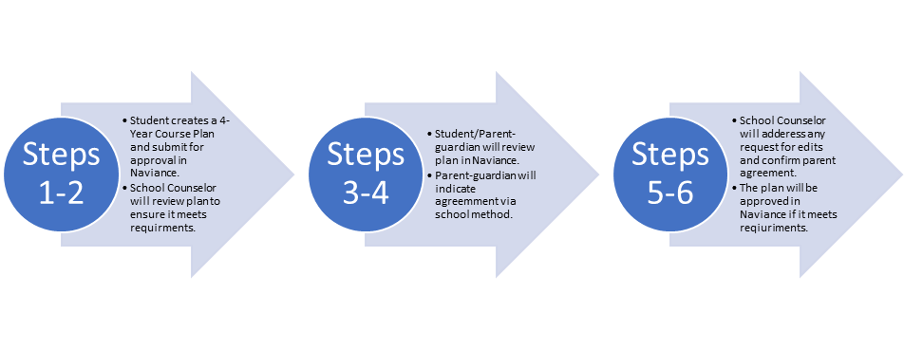
4-Year Course Plan Approval Process
Notes:
Sufficient notice should be provided by school regarding parent meeting and School will share a specific start/end date when sessions will occur for students.
School will proceed with the approval process and share how a copy of the plan can be obtained on or before June 11

Slide 47
SEM Advancement Act:
Expanding Student Opportunities for
Advanced Courses

Slide 48
What is the SEM Advancement Act?
The SEM Advancement Act is a new state law that expands students’ access to advanced courses.
  All 7-12 grade students who meet the criteria for advanced courses in ELA, mathematics, and/or science will be identified and notified in writing.
  These courses include, but are not limited to:
    Honors
    Advanced Placement (AP)
    Cambridge International
    Capstone Industry Certification-Aligned
    College Level Exam Program (CLEP)
    Dual Enrollment (DE)
    International Baccalaureate (IB)
    Local and Statewide Dual Credit
  Families who do not wish to take advantage of advanced courses may opt out of this opportunity in the PowerSchool parent portal.

Slide 49
How can my child participate in advanced courses?
Students with a B or higher AND a score of On Track/Mastery on the TCAP Achievement/EOC in their previous ELA, mathematics, and/or science course will be automatically enrolled into the next respective Honors course(s) based on class availability.
Students who do not meet these criteria may still be considered for Honors courses.
Students may also be eligible for advanced courses such as Advanced Placement (AP), Dual Enrollment (DE), International Baccalaureate (IB), Local and/or Statewide Dual Credit (LDC/SDC), or Industry Certification (IC).
  These courses are Early Postsecondary Opportunities (EPSOs) that enable students to potentially earn college credit while in high school.
  All students who meet the eligibility criteria will be notified in writing.
Talk to your child’s school counselor for more information!

Slide 50
The MSCS Commitment to Our Students

Slide 51
The MSCS Commitment to Our Students
What parents can expect:
  Personalized learning plans for each child
  Frequent Communication about student progress via parent letters, Academic Scorecard, and report cards
  Share distinct usernames and passwords for intervention that student can access at both home and school
  Grade and content academic support events throughout the year
  Access to parent resources via scsk12.org

Slide 52
School Communications Updates
TREADWELL INTERNATIONAL COMMUNITY SCHOOL - 920 N.Highland St.
901-416-6100
Principal – Brandon Hill hillb@scsk12.org
Assistant Principal – P. McKinney mckinneypk@scsk12.org
Assistant Principal – C. Williams williamscn@scsk12.org
PLC Coach – S. Jeffries jeffriess@scsk12.org

Slide 53


MSCS Family and Community Engagement

Slide 54
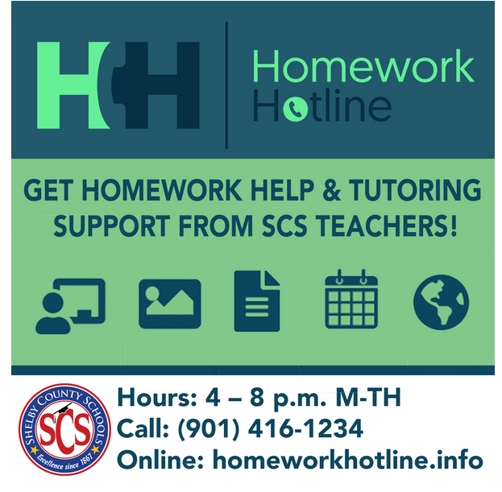
Family and Community Engagement Ongoing Support
  Homework Hotline: Certified Teachers tutor K-12 Tennessee students in all core subjects
      Help is offered in seven languages: English, Arabic, Spanish, Hindi, Farsi, Mandarin, and Swahili.
      Teachers are available Mondays-Thursdays, 4p.m.-8p.m. via phone (901)416-1234 and webchat http://homeworkhotline.info/
Family and Community Engagement Ongoing Support

Slide 55
The Commitment to our Parents

Slide 56
Family and Community Engagement Ongoing Support
Monthly Family Forums: provide an opportunity for all parents to gather, learn, and share important information to support student learning and success in school. Families can join the live virtual sessions on Microsoft Teams by visiting www.scsk12.org/familyforum.
Family and Community Engagement Ongoing Support

Slide 57
Before and After School Tutoring Program 22-23

Slide 58
About the Tutoring Progam
Structured tutoring programs have been proven to significantly increase student achievement when implemented in a clearly defined program that encompasses consistency, quality materials, and well-trained tutors. Our before/after school tutoring program is aligned as follows:
Dates: September 6, 2022-April 14, 2023
Students Impacted: 11,000
1:10 ratio maximum; 1:5 ratio minimum
3 hours per week & 2 Saturdays per month (optional)
Elementary students will receive additional instruction in ELA and/or Math
High school students will receive additional instruction in EOC content (9-10) and ACT prep (11-12)
Schools can decide whether a student participates in ELA or Math based on the student data
Students will not participate in both ELA/Math within the same semester
Students can potentially receive tutoring in one subject the first semester and a different subject the second semester

Slide 59
Turtoring Expectations
We ask that your child commits to our free tutoring program and guidelines by doing the following:
Be in attendance for every session
Be on time
Be prepared to learn
Be engaged in all lessons
Be attentive to the assigned tutor
Be respectful to classmates and assigned tutor

Slide 60
Important Information
Spaces are available on a first come, first serve basis
Students will need to be picked up promptly at (Add the time our tutoring ends)
After Tutoring Dismissal will occur (Add information specific to your school)
Students will need to be signed out from the After-School Tutoring Program
Before school tutoring drop off is located (Add information specific to your school)
Students will need to be signed in for the Before-School Tutoring Program
After-school tutoring snacks will be provided

Slide 61
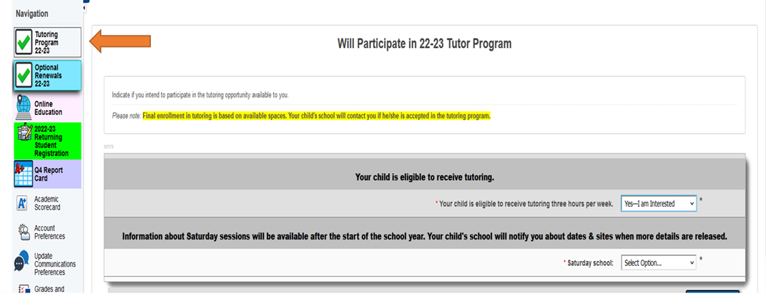
How to Register
Login to the PowerSchool Portal from a laptop or desktop
Select the green Tutoring Program Tab

Slide 62
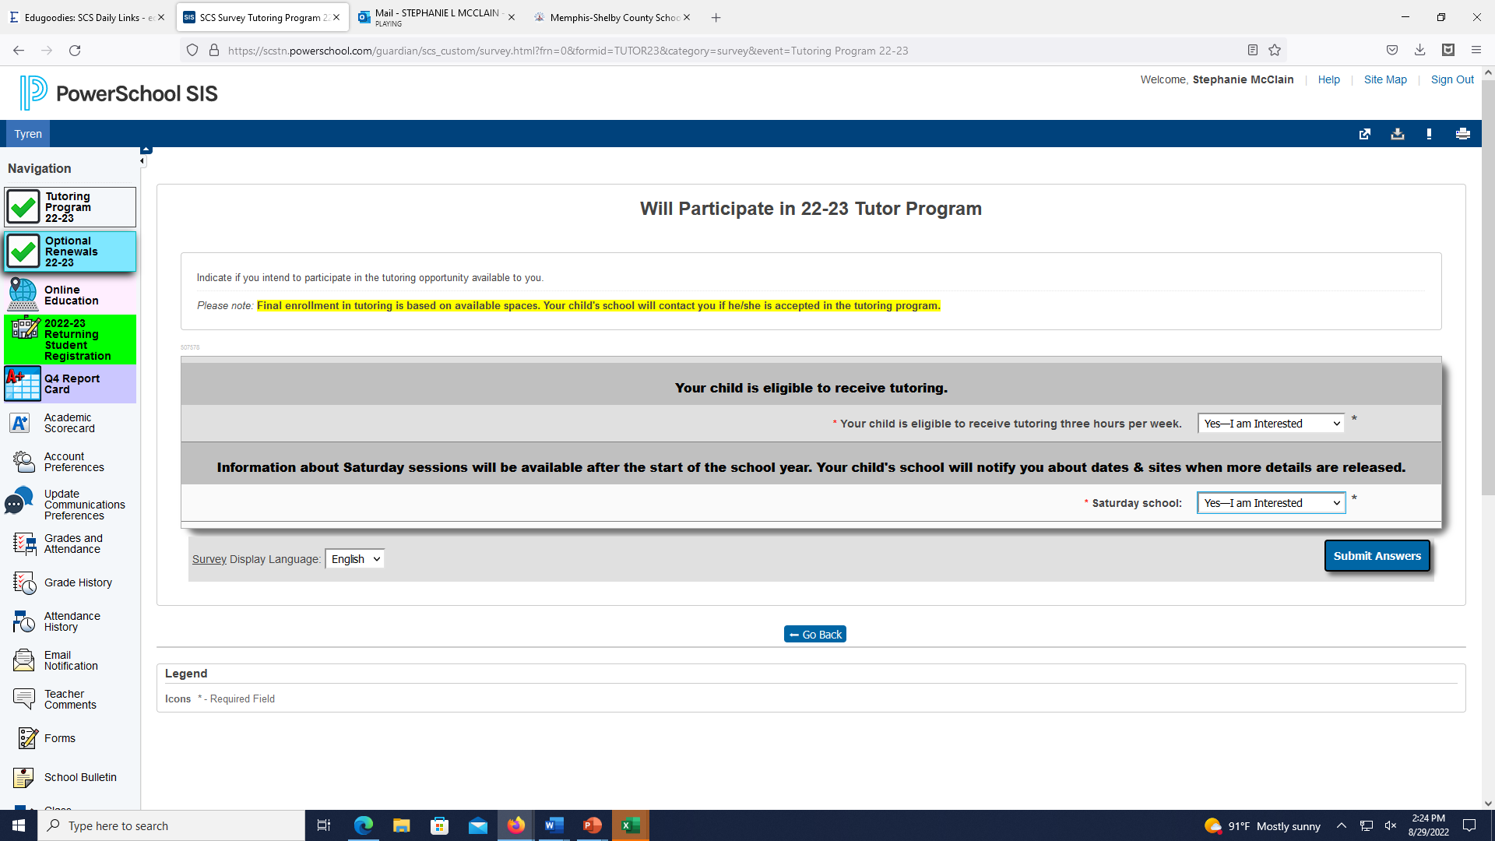
How to Register
Answer both questions on the application
Submit Answers

Slide 63
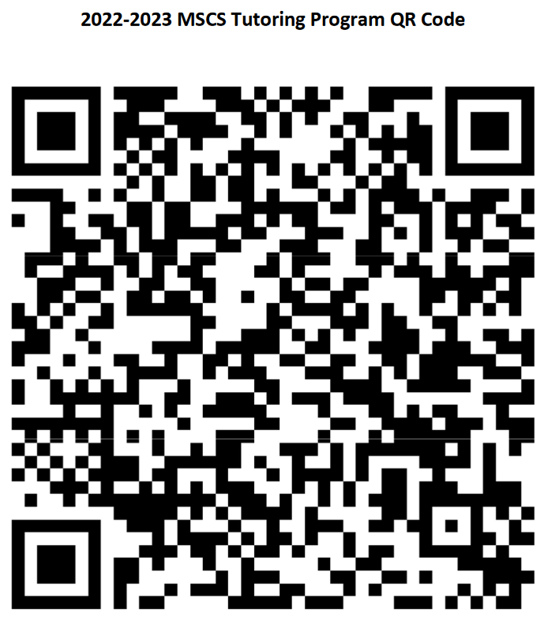
Enrolling Students QR Code
If you ate having difficulty accessing PowerSchool, use the QR code to register.

Slide 64
Days & Times of Tutoring Program
Tuesday & Thursday
3:30pm – 5pm

Slide 65
Contact Information
Elaine Hunt
901-416-6100
hunte2@scsk12.org

Slide 66
S.E.E.D Registration/Enrollment, Withdrawals, & Transfers

Slide 67
S.E.E.D Registration/Enrollment, Withdrawals, & Transfers
Questions
Parents must complete Registration once a year by logging into their Parent Portal and completing the online application.
Registration for the 2023-24 school year will begin during the second semester. Parents are able to complete registration for the following year before this school year ends.
Parents that are unaware of their student’s assigned school for the next year can click here https://portal.schoolsitelocator.com/apps/ssl/?districtcode=70300
Entering Kindergarten students must turn 5 by August 15th to be able to register and enroll.
Each year 4-year-olds who will be turning 5 from August 16 - September 30 early entrance into Kindergarten. These children must be screened to determine if they will be eligible to enter into Kindergarten early.
School Choice opens in January.
School Choice Priority Period for applicants that apply opening week, will know their status by 2/17/2023.
School Choice re-opens 8/1/2023 – until the last Friday of the first week of school
School Choice has five specialty schools that have a wealth of opportunities for MSCS students: (Mt. Pisgah High, Bolton Agri-STEM, Medical College High, Middle College High, & Hollis F. Price)
If Parents need assistance, the ERA team will be available to assist at the Board Of Education during opening week of the School Choice application. Parents can also visit a Memphis Library to gain computer access.
School Choice transfer is based on space.
Withdrawal requests are now in the Parent Portal
Withdrawal requests are not the same as a transfer request

Slide 68

Discussion
Questions
???

Slide 69
Student Data Discussions, Parent-Teacher Conferences, & Next Steps

